Slide 1

Predicting Employee Attrition
Kyle Rodriguez

Slide 2



Problem Identification Overview
High Cost of Turnover
Lost Productivity
Identify At-Risk Employees
Replacing an employee costs 1.5-2x their salary on average
Two thirds of turnover costs are intangible like lost knowledge and internal strain
Predicting turnover could minimize costs and increase retention
Proactively identifying employees likely to resign would allow companies to reduce turnover costs and retain talent.

Slide 3
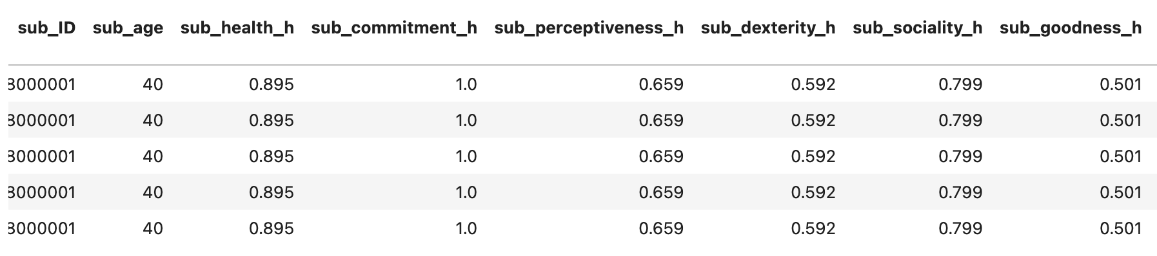
Data and Method
This synthetic dataset contains 18 months of daily performance and attrition data for a factory with 508 workers.
Due to employee turnover, there were a total of 687 persons in the dataset. The dataset had around 412,000 rows and 42 distinct features.

Slide 4






EDA: Employee Hidden Traits
This dataset contained hidden trait values on a range from 0 - 1 for both employee and supervisors.
The traits influence the kind of events an employee/supervisor might perform. Of the employees that resigned, the average range their values fell within was between 0.7 - 0.9.

Slide 5
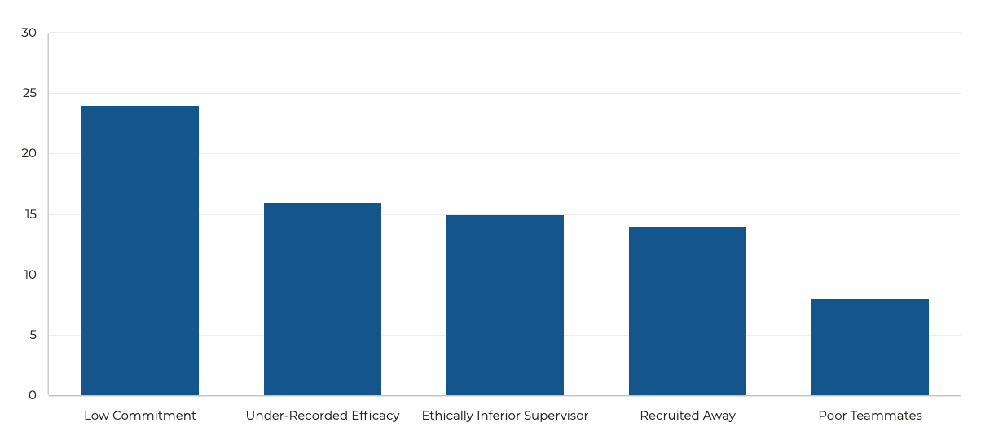

EDA: Reasons for Employee Resignations
24
16
15
14
8

Slide 6


EDA: Mismatched Event Records
In total, there were 3,938 instances where a given event was recorded as something different by the supervisor than what actually took place - especially positive events.
Events
Recorded Differently by Supervisor
Actual Event
Difference
Efficacy
191272
191657
-385
Feat
3387
3937
-550
Idea
3334
3899
-565
Sacrifice
4605
5356
-751
Teamwork
4090
4814
-724
These mismatched events could be a source of frustration felt by employees, ultimately contributing to their resignations.

Slide 7
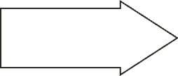
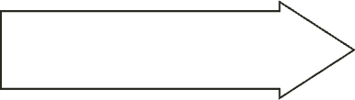
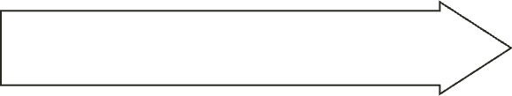
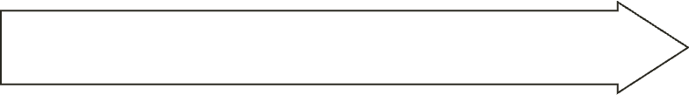
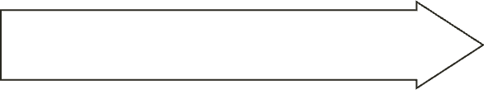
Target Feature
Data Preprocessing Steps of Note
One-hot encoding categorical variables
Feature Engineering Mismatches
Oversampling the Minority Class

Slide 8
Model Description
Binary classification problem
Used logistic regression for the first model due to the binary nature of predicting employee resignation.
Model types
Random Forest and Catboost models were chosen in addition to logistic regression.
Feature engineering
Identified feature matrix X and target y from the dataset.
Train test split
Split data into training and test sets with 30% test size.

Slide 9
Model Performance
Accuracy scores of models on oversampled dataset
0.92
Random Forest
0.95
Logistic Regression
0.98
CatBoost

Slide 10
Model Performance
AUC scores of models on oversampled dataset
0.88
Random Forest
0.90
Logistic Regression
0.89
CatBoost

Slide 11


Model Findings
Important Features Ranked for the Logistic Regression Model
Feature
Importance
Being on Team 17
1
Being on Team 9
2
Supervisor with low perceptiveness score
3

Slide 12
Model Findings
Important Features Ranked for the Random Forest Model
Feature
Importance
Number of Under-recorded Efficacy Events
1
Number of Mismatched Events
2
Supervisor with low Goodness score
3

Slide 13
Model Findings
Important Features Ranked for the CatBoost Model
Feature
Importance
Number of Under-recorded Efficacy Events
1
Supervisor with Low Goodness Score
2
Supervisor with Low Commitment Score
3

Slide 14
Business Recommendations
1
Re-evaluate how metrics are recorded by Supervisors, aimed at minimizing mismatches.
2
Incorporate behavioral-based interview questions when interviewing managerial candidates to assess candidate's perceptiveness, goodness and commitment.
Taking an aggregate of the findings across the three models, the pain points that can be addressed include: Minimizing Event Mismatches by supervisors, Assessing Supervisor Perceptiveness, Goodness and Commitment.

Slide 15
Next Steps
Tuning
Incorporate More Data
Tune model hyperparameters to optimize performance metrics
Add features like commute time and salary
Hidden Traits
Incorporate proxy data for unrealistic hidden traits

